Slide 1
Reading Data & Creating Datasets
Business Intelligence Systems and Data Mining IMAT5168 Analytics Programming

Slide 2
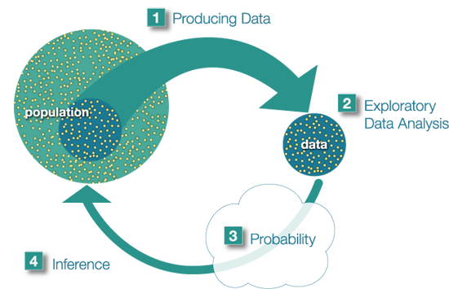
Big picture of statistics
https://oli.cmu.edu/repository/webcontent/b83cca4680020ca601894e758ec447b9/_u1_intro_stats_online/webcontent/inference.png

Slide 3

Initial list of tasks
Produce data
Read in raw data from one or more files
Use informats and data step programming to create SAS variables
Explore data
Examine data using summary tables and graphs based on the research question
Use data step programming to “clean up” data
Probability
Implement various statistical models and assesses their validity by examining assumptions
Use data step programming to create new variables based on the results of models

Slide 4
Structured programming
Metaphor: divide and conquer…
Working definition
Create an initial list of tasks
Repeat until the program is finished:
Can each task be written as program statements?
If yes:
STOP
If no:
Break the task into a list of sub-tasks

Slide 5
Iterative development
Structured programming
Expected
results
Test run
Actual results
Refinements to program

Slide 6
Refinement of initial tasks
Input raw data
Input data from datalines
Exploratory data analysis
Summarize folate
Probability
Model folate versus ventilation
Using ANOVA
Check assumptions
data amess1978;
input ventilation folate @@ ;
datalines; … ;
run;
proc univariate data = amess1978;
class ventilation;
var folate;
qqplot /normal(mu=est sigma=est);
histogram /normal;
run;
proc glm data = amess1978;
class ventilation;
model folate=ventilation;
means ventilation
/lsd hovtest=bartlett;
output out=amess1978p
p=predicted r=residual;
run;
proc univariate data=amess1978p;
var residual;
qqplot /normal(mu=est sigma=est);
histogram /normal;
run;

Slide 7
Develop in small steps
Always start from the smallest working data step program that could possibly work, for example:
data output_dataset;
input a;
datalines;
1
;
run;
Add new code one step at a time…
If there is an error, the error must be in the new or changed code.
It should be easy to work out what was wrong and how to fix it.
Use a version control system to keep track of changes

Slide 8
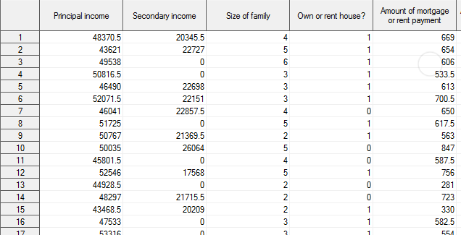
SAS Data Set Example

Slide 9
SAS data sets
A data set is a 2 dimensional table of rows and columns.
Each row represents data about one subject.
Each column is a ‘variable’ that stores a measurable feature of the subject.
There may be one or more rows per subject.
One or more columns may be repeated to record the same measurement many times
pulse_rate1, pulse_rate2, pulse_rate3
represents pulse rates taken at 5, 15 & 30 minutes after arriving at a GP
For database aficionados only…
The data are not normalised.

Slide 10
Anatomy of a SAS variable
Length
Size in characters
Data type
Numeric or text
Informat
The informat determines how data being input will be interpreted.
Outformat
The outformat determines how the variable will be formatted when printed in output.
Name (to use in code)
This is the name programs will use to refer the variable.
Label
This is the name for the variable’s column/axis to be used in tables or graphs.

Slide 11
Taxonomy of statistical data types
 | Text ($) | Numeric
Nominal | Categories coded as text Convert to a number? | Categories coded as numbers (+1 has no meaning)
Ordinal | Ordered categories Convert to a number? | Ordered categories coded as numbers (World ranking) (+1 has no meaning)
Interval | Not applicable | Numbers where only add & subtract valid (Date) +1 has a meaning, 0 has no meaning
Ratio | Not applicable | Numbers where add, subtract, multiply & divide valid +1 has a meaning, 0 has meaning
Representation of missing values in SAS
Text: ''
two single quotes
Numbers: .
dot/period
Dates are treated as numeric data
Each date is the number of days after 1/1/1960

Slide 12

Implementation SAS Data Type: numeric variable
Missing value = .
Built in operations:
Arithmetic
+ - add, subtract
* / multiply, divide
** (x**y = $x^{y}$)
Comparison operators
< less than
> greater than
>= greater than or equal to
<= less than or equal to
~= not equal
Mathematical and statistical functions
See:
https://go.documentation.sas.com/?cdcId=pgmsascdc&cdcVersion=9.4_3.4&docsetId=lefunctionsref&docsetTarget=n01f5qrjoh9h4hn1olbdpb5pr2td.htm&locale=en

Slide 13
Implementation: SAS Data type character variable
Specify with $ after the variable name
Missing value = ''
Operations
Comparison operators
< less than
> greater than
>= greater than or equal to
<= less than or equal to
~= not equal
Caution: international character sets
Functions to manipulate, convert and find text in character strings
See:
https://go.documentation.sas.com/?cdcId=pgmsascdc&cdcVersion=9.4_3.4&docsetId=lefunctionsref&docsetTarget=n01f5qrjoh9h4hn1olbdpb5pr2td.htm&locale=en

Slide 14
Data step processing overview
Compile phase
Declare space to store the line of data from the input file
Input buffer
Declare space for the required SAS variables
Program data vector
Initialise useful information about the process
Execution phase
Write the current variables to the data set
Reset all variables to missing
Build the next observation
read a line of data
use input statements to translate the text into a SAS variable
use data step programming statements to alter/add to SAS variables

Slide 15
Anatomy of the data statement
Each data step will contain data and source; the remaining elements will depend on the task.
data <output data set>;
source
set <input another SAS data set>;
infile <input a raw data file>;
length
length <lengths of variables>;
format
informat <informat definitions for variables>;
variables
input <variables>;
programming statements
if <condition> then <action>;
output <output the current set of variables>
output formatting
format <outformat definitions for variables>;
label <labels>;
data
datalines <data>;
run;

Slide 16
Strategy for data statements
Look at the source data
What format is it in?
Which input statements will help?
Identify any rows that are obviously unusual
Put them and one “standard” row in a test file or a datalines statement
Write the data statement to read the test data
ALWAYS look at the log
Check that the right number of records have been read
If there is an error, refine the data statement
Always view the data set itself
If the data are incorrect, refine the data statement
When the data statement is correct
Read the full dataset
Check the log for errors
Use univariate stats (continuous) or frequencies (categorical) to check data

Slide 17
Types of input
Column input General form: V[V]
123456789+123456789+ V = value
1 Smith 196412081 V₁= name 1-8, V₂ = Year 9-12
2 Williams197311075 V₃= SBP 13-15, V₄ = DBP 16-17

Slide 18
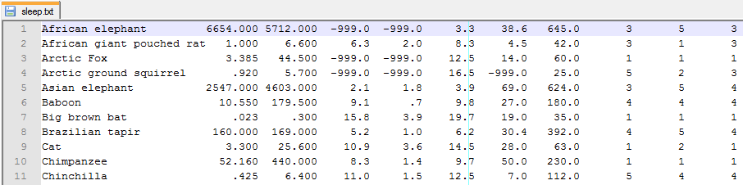
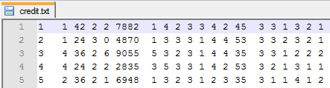
Data arranged in columns

Slide 19
Data step for columnar data
data customer;
infile
'credit.txt'
missover
;
input
customer 1-3 /* ID Number */
account 5 /* Chequing account */
duration 7-8 /* Duration in months */
history 10 /* Credit history */
/* more variable definitions here */
;
run;

Slide 20
Input buffer underflow
Underflow: less data than used by all variables
flowover (default)
read next record & continue inputting variables
missover
set current variable to missing
start a new data step iteration with a new record
truncover
set current variable using available characters
start a new data step with a new record
stopover
stop data step processing

Slide 21
Informats
Predefined informats
For date & time
For formatted numeric data
1.2e+33, $33.54
User defined, if no predefined informat
Example use: to convert character data to numeric
to save space, thereby increasing processing speed
to simplify processing

Slide 22
Example numeric informat convert text to number
proc format;
invalue team
'red' = 0
'yellow' = 1
'green' = 2
'blue' = 3
other = .
;
run;

Slide 23
Example character informat convert code to category
proc format;
invalue $team
'r' = 'red'
'y' = 'yellow'
'g' = 'green'
'b' = 'blue'
other = ''
;
run;

Slide 24
Labels and outformats: make SAS output user friendly
Annotate variable names with labels
Use an output format to name numeric codes
data output;
/*
use as part of a data statement
*/
label
customer = 'ID Number'
account = 'Chequing account'
duration = 'Duration in months'
history = 'Credit history‘
/* more items here */
;
/* more data statement here */
run;
proc format
value account * create output format;
1 = '< £0' * what is printed;
2 = '£0 - £200'
3 = '>= £200'
4 = 'no account'
. = 'missing'
other = 'ERROR‘
;
run;
/* where to find the format */
options fmtsearch = (loanrisk);

